Slide 1

futsa
A WEB BASED FUTSAL BOOKING SYSTEM

Slide 2
Team Members
Amrit Adhikari(19180047)
Chiranjibi Ranabhat(19180056)
Saroj Aryal(19180076)
Suraj Gautam(19180089)

Slide 3

Introduction
Futsa is technical way of managing the futsal booking process. It is developed to assist everyone who loves to play futsal and are futsal owners.

Slide 4
Problem Statement
Waste of time to reserve futsal with conventional method,
Difficulty in finding the futsals near your city,
Conflict may araise when multiple teams arrive at same time,
Record of booking in log book.

Slide 5
Objectives
To find the nearby and easily accessible futsals,
To eradicate complicated phone based booking processes,
To enable the user to book the playing schedule.

Slide 6
TECHNOLOGIES USED
React Js ( Frontend )
Tailwind Css ( Css Prefixer )
Node Js ( Backend Language )
MongoDB ( Database System )

Slide 7
DESIGN OVERVIEW
Home page
Login page
Register page
Admin panel
Database

Slide 8
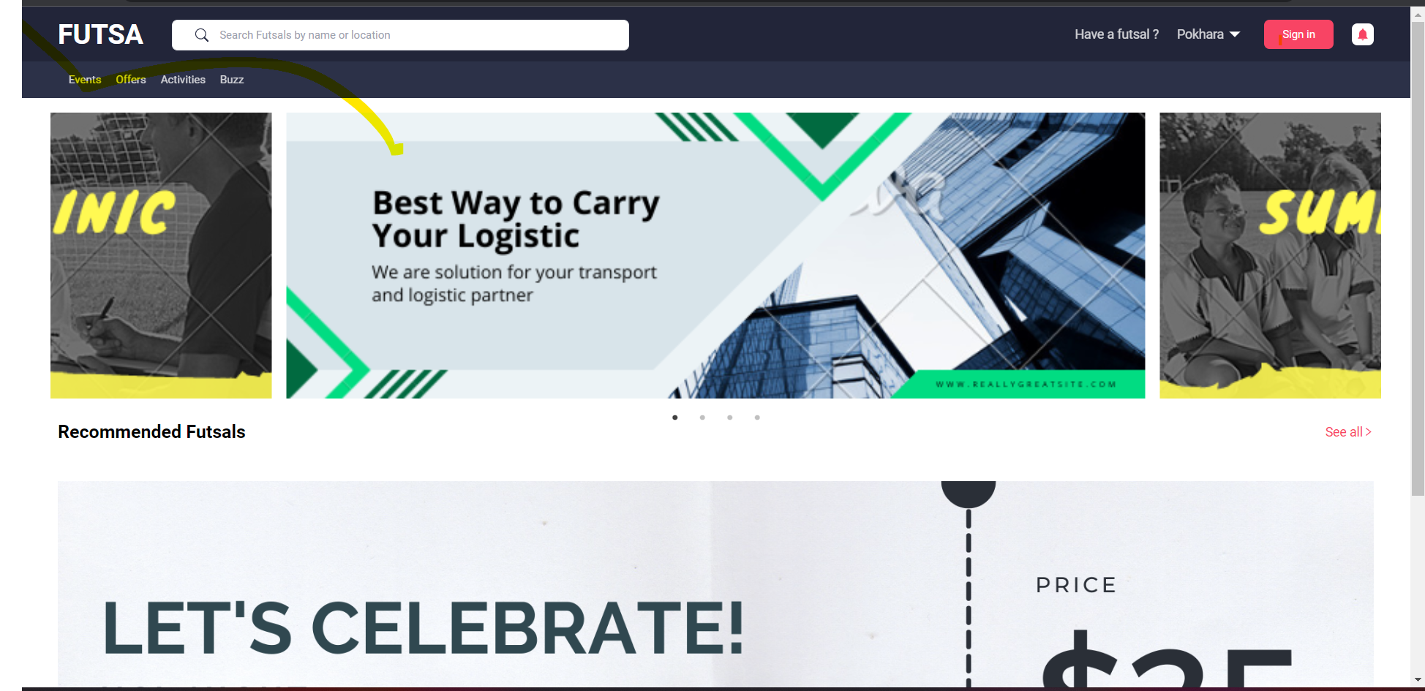
Home page

Slide 9
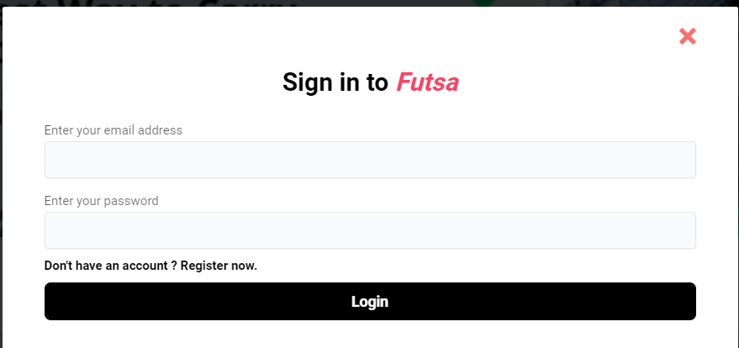
User Login

Slide 10
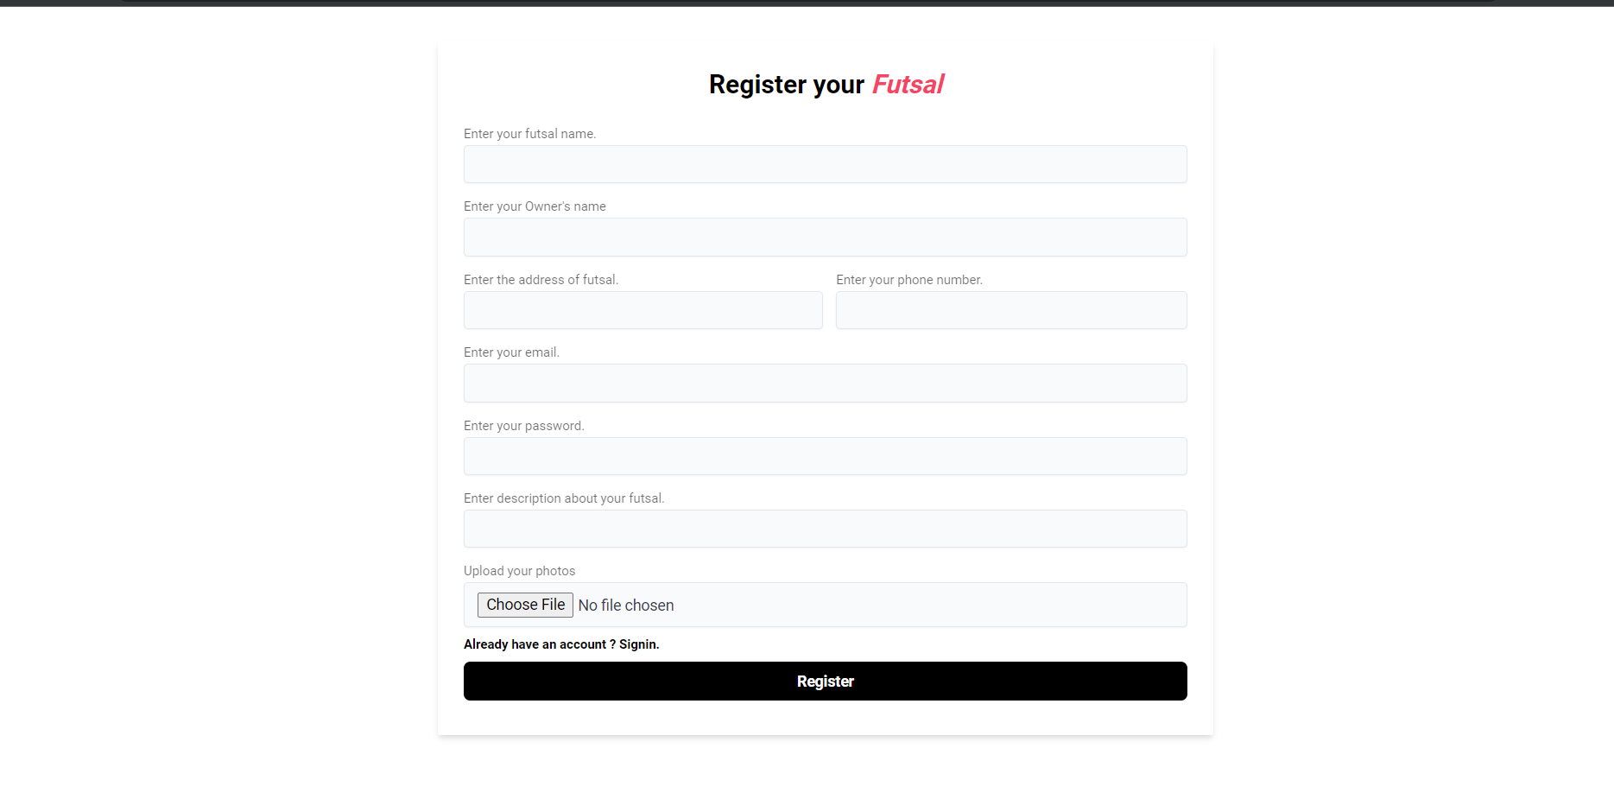
Register futsal

Slide 11
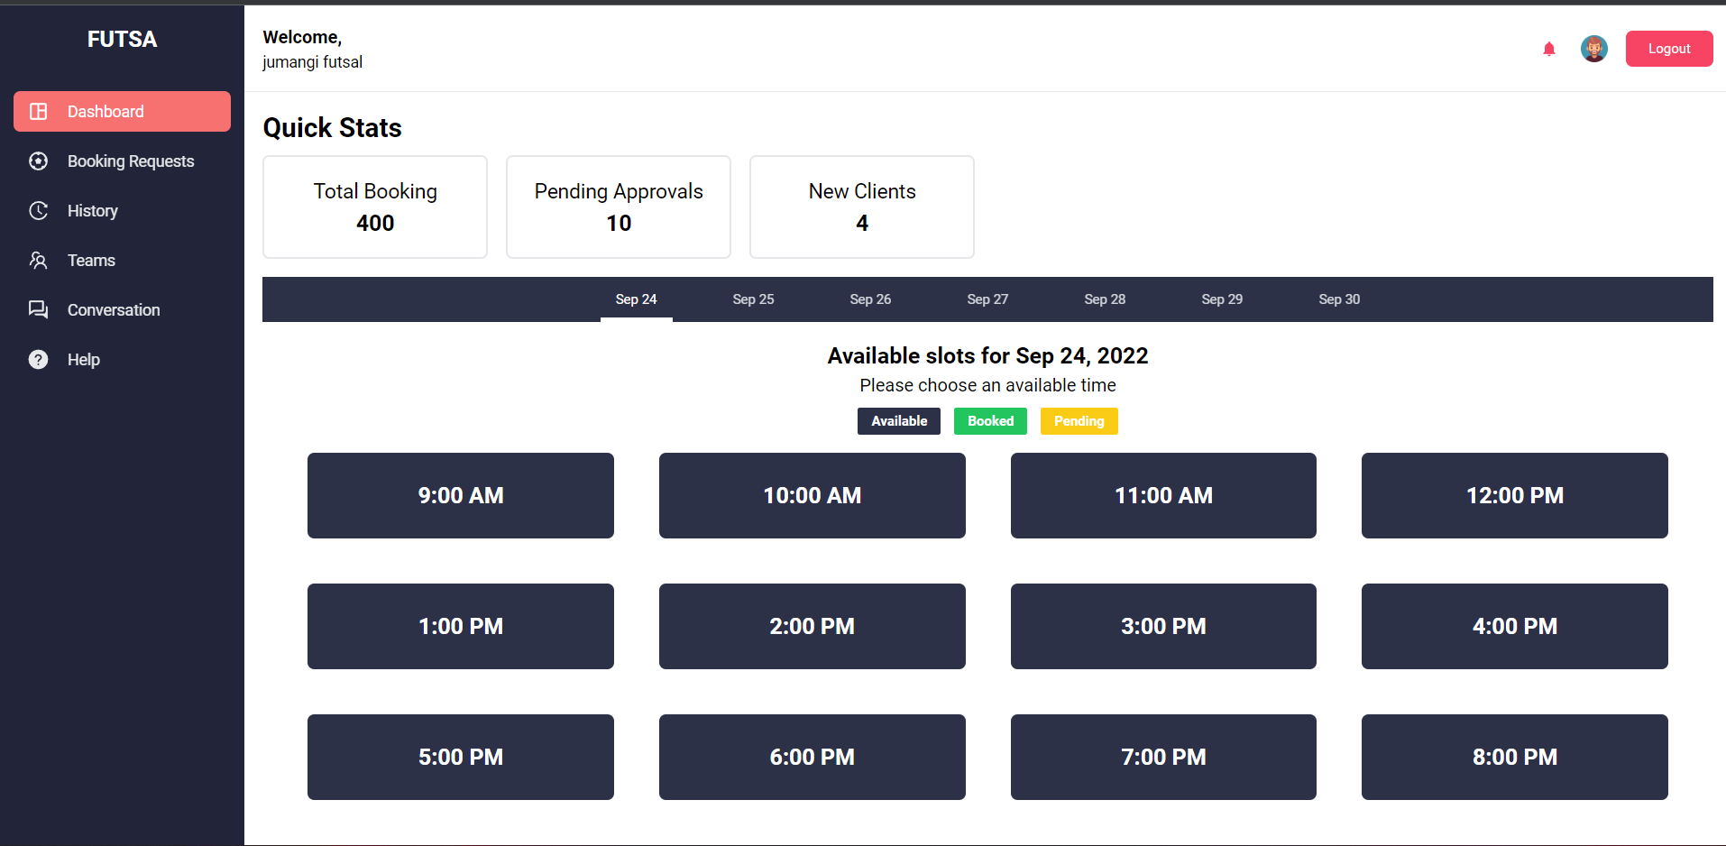
Admin Dashboard

Slide 12
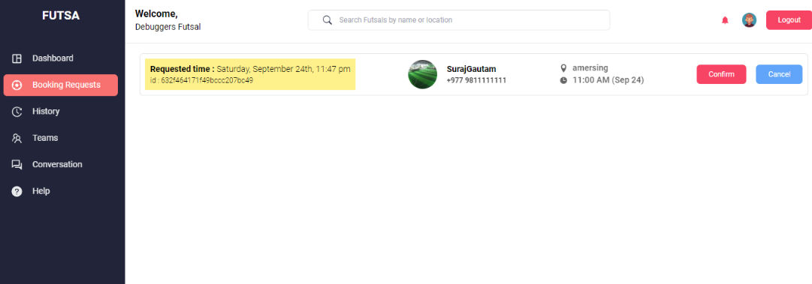
Booking Requests

Slide 13
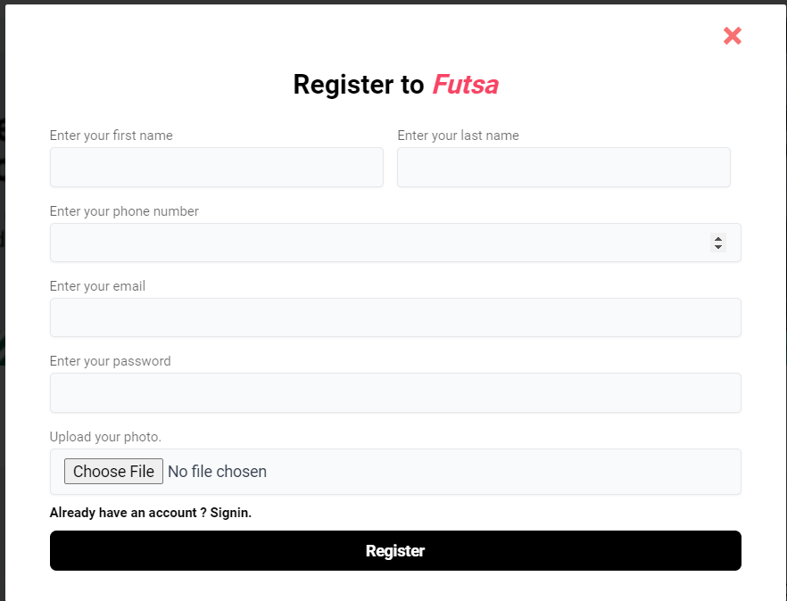
Register new account

Slide 14
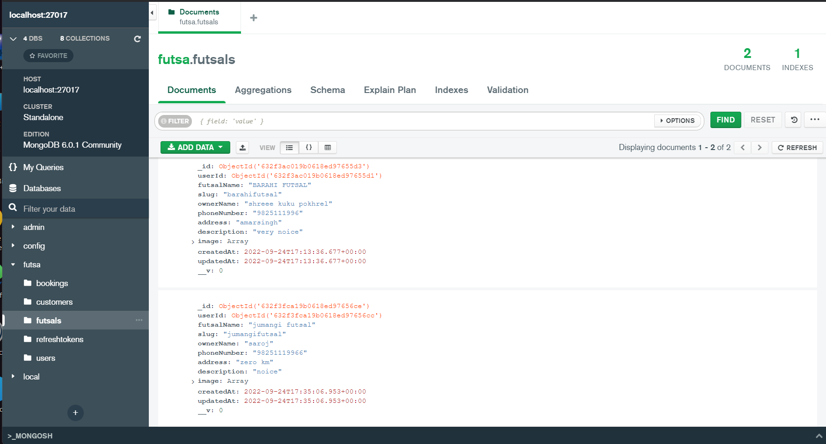
DATABASE

Slide 15
Live Demonstration

Slide 16


Slide 17


